Slide 1
The RELaTıonSıp bEtween my Step Counts and The weather
Can kargın 32202

Slide 2
HYpotheses1
Null Hypothesis ( Ho ) : There is no statistically significant relationship between the average temperature and the daily total number of steps.
Alternative Hypothesis ( H1) : There is statistically significant relationship between the daily average temperature and the daily total number of steps. The observed relationship in the sample data reflects genuine association, suggesting that temperature may influence daily step counts.

Slide 3
Hypotheses2
Null Hypothesis ( Ho ) : There is no statistically significant relationship between the average wind speed and the daily total number of steps.
Alternative Hypothesis ( H1) : There is statistically significant relationship between the daily average wind speed and the daily total number of steps. The observed relationship in the sample data reflects genuine association, suggesting that wind speed may influence daily step counts.

Slide 4


My dataset
1) Apple Health Data 2) Meteostat Weather API

Slide 5


Step count Data

Slide 6
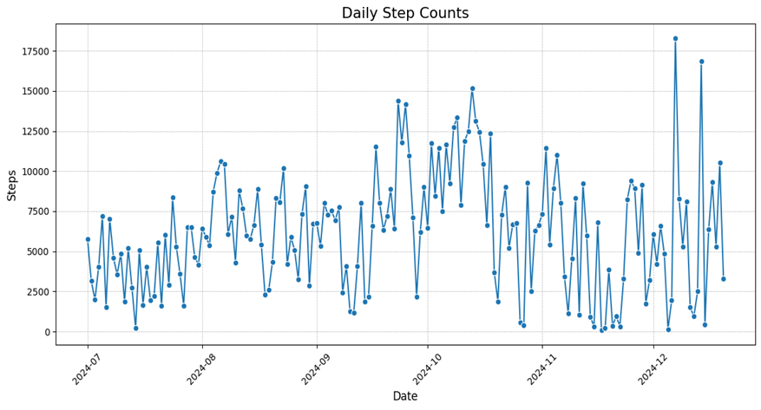
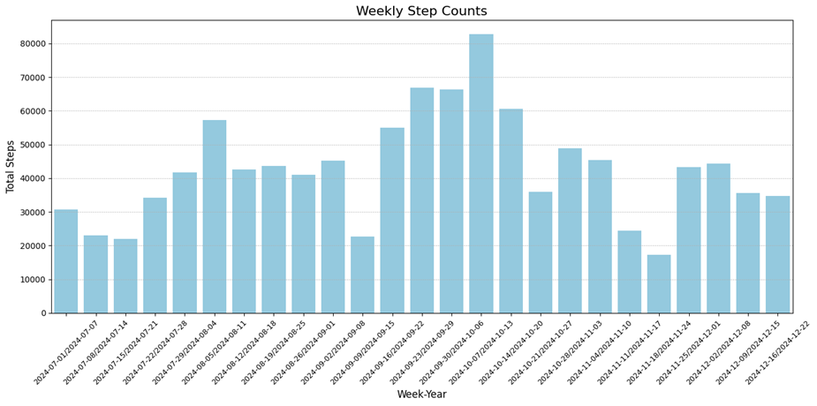
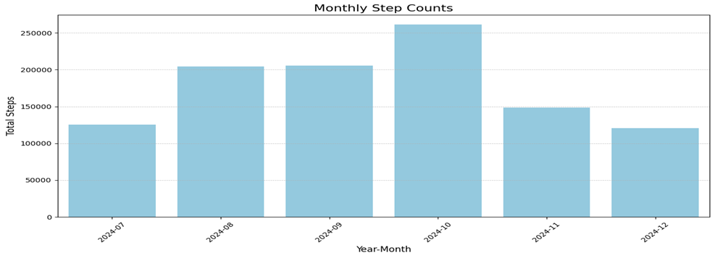
I began this project by examining the number of steps I took and then visualizing them as daily, weekly and monthly counts. There seems to be no trend.

Slide 7
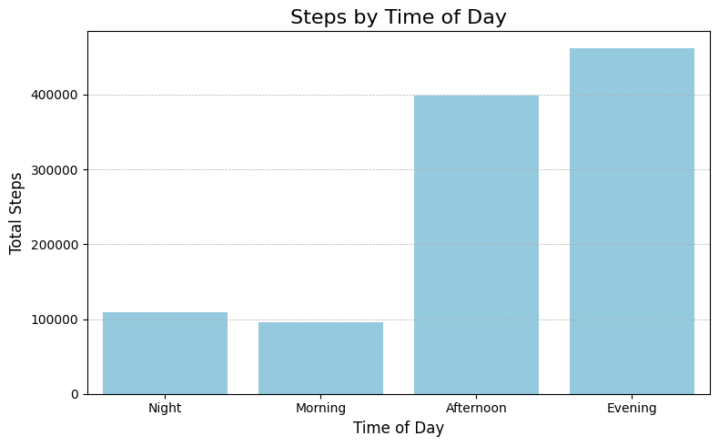
This graph illustrates the total number of steps I took in each time period ( morning, afternoon, evening and night.) As shown, my step count during the evening is notably higher than in the other time periods.

Slide 8


Weather data

Slide 9
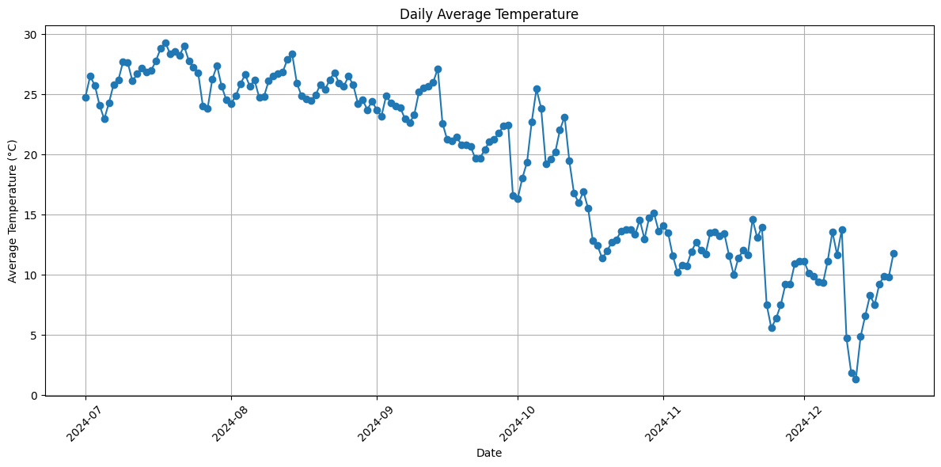
After reviewing my step counts, I shifted my attention to the weather conditions at Sabancı University. This chart shows the daily average temperature ( in °C) over a six-month period.

Slide 10
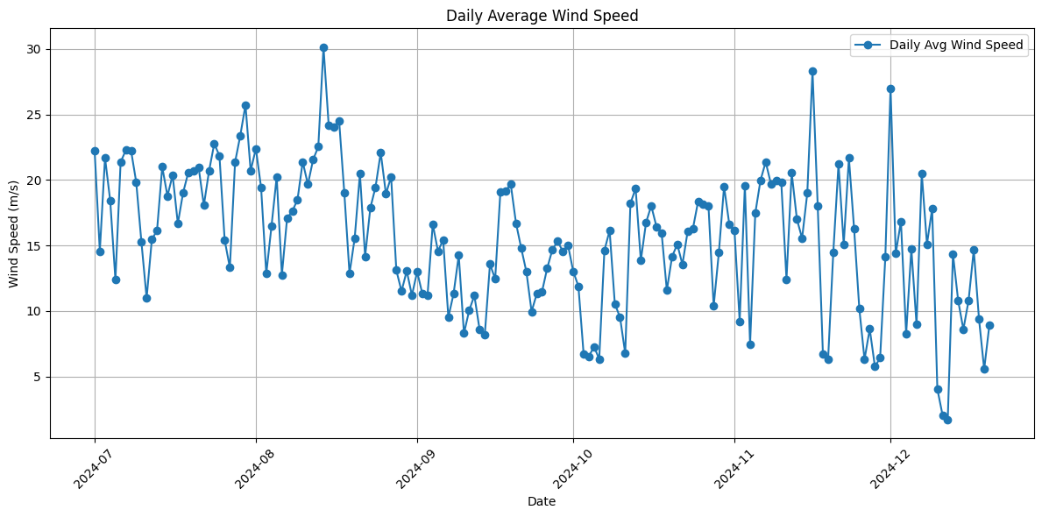
I have chosen wind speed as my second weather variable. This plot illustrates the average daily wind speed, measured in m/s, over a six-month period.

Slide 11
Then, I combined both datasets and assessed whether whether my hypotheses held true.

Slide 12
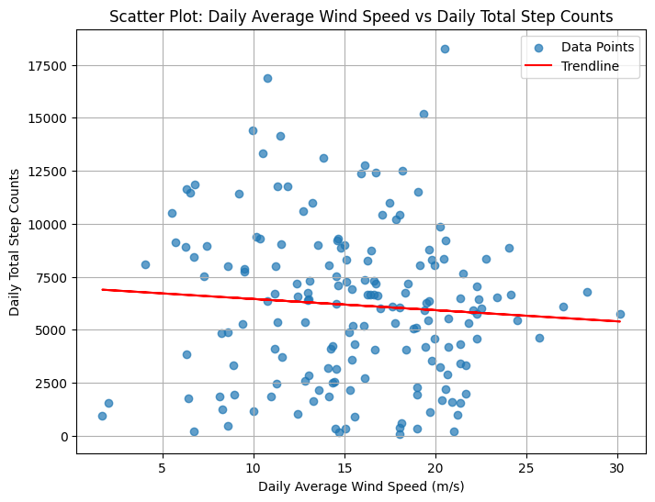
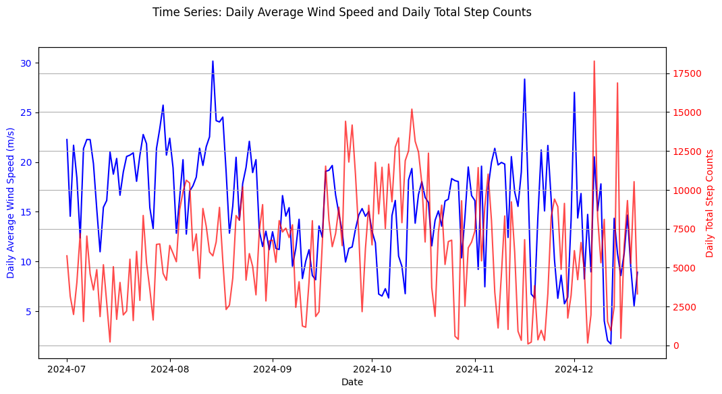
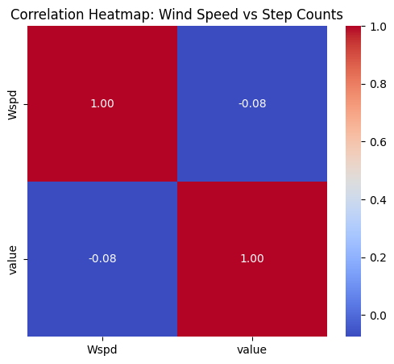
From the figures, it appears that there is a very weak negative relationship between wind speed and step counts. In other words, higher wind speeds are ‘’slightly’’ associated with fewer steps, but this link is so minimal that it cannot be considered significant.

Slide 13
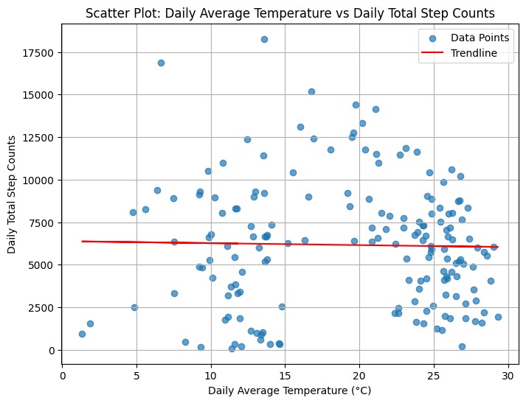
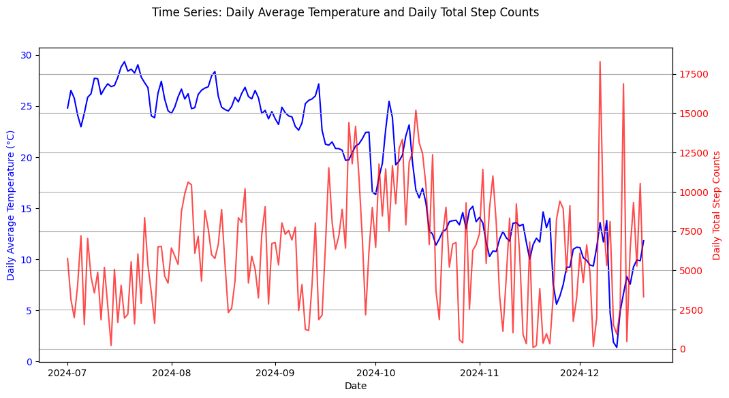
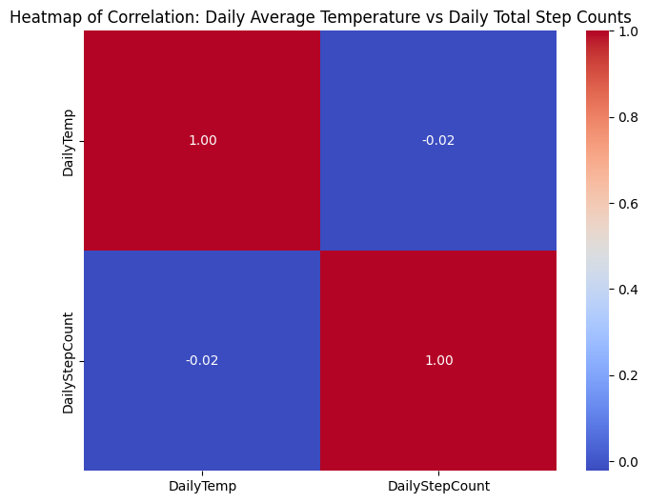
Based on these figures, there is essentially no meaningful relationship between temperature and step counts. The correlation is around -0.02 , indicating that variations in temperature do not have a clear impact on the number of daily steps.

Slide 14
Conclusıon-1
1)Temperature vs. Step Counts:
Correlation Coefficient : -0.022 / P-value : 0.772
2) Wind Speed vs. Step Counts:
Correlation Coefficient : -0.075 / P-value : 0.325

Slide 15
Conclusıon
Both the p-values exceed the significance level of 0.05, so we fail to reject the null hypotheses outlined at the beginning of the presentation.
Consequently, this means that we do not have statistically significant evidence to support my alternative hypotheses.

Slide 16
Thanks for seeing my work !!

